Slide 1
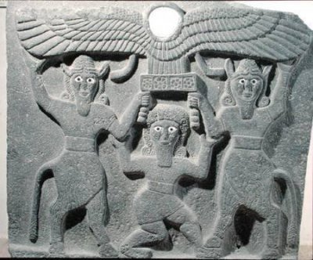
Since when have the Arameans used the name Suryoye(Syriacs)?

Slide 2
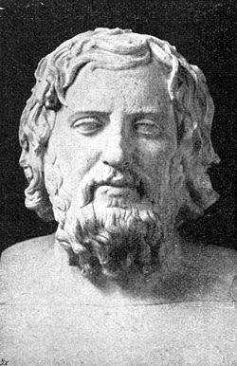
Xenophon
Xenophon Ca 430 – 354 BCE
ὁ δὲ τῶν Ἀσσυρίων βασιλεὺς κατεστραµµένος µὲν πάντας Σύρους” (O de ton Assurion Basileus katestrommenos men pantas Surous) which means.”The Assyrian king subjugated the Syrians”
Σύρους (Syros/Suros) refers indirectly to the ancient Arameans here. The Arameans still called themselves Arameans but the Greeks like Xenophon called them Σύρους (Syros).
(Cyropaidea - book 1, chapter 5,verse 2. PS My own mirror English translation of the Greek quote. The English version in the book itself is not a perfect mirror translation I prefer older Swedish version than 1998 it is closer to the Greek text)

Slide 3
Septuaginta
“During the 3rd century B.C., when the Hebrew Bible was translated into the Greek Septuagint for the use of the Hellenized Jews of Alexandria, the terms Aramean [hebrew: Aramim] and Aramaic [Hebrew: Aramit] of the Hebrew Bible were translated into “Syrian” [greek: syros/syrioi,] and “the Syrian tongue” [greek: Suristi] respectively.”
(Bracket info added by me; read ”Assyria & Syria: synonyms?” paper by John Joseph Vs. Richard Nelson Frye, in Journal of Assyrian Academic Studies [JAAS] page 38 and John Josephs book ”The modern Assyrians of the Middle East – encounters with western christian missions archeologists and colonial powers – brill 2000, page 9)

Slide 4
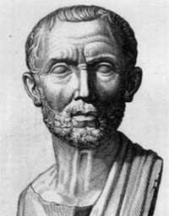
Posidonius of Apamea
Posidonius of Apamea (ca. 135 BC - 51 BC)
"The people we Greeks call Σύριοι/Surioi, they call themselves Αραμαϊoi/Aramaioi.
(See J.G. Kidd, Posidonius (Cambridge Classical Texts and Commentaries, 1988), vol. 2, pt. 2, pp . 955-956)

Slide 5
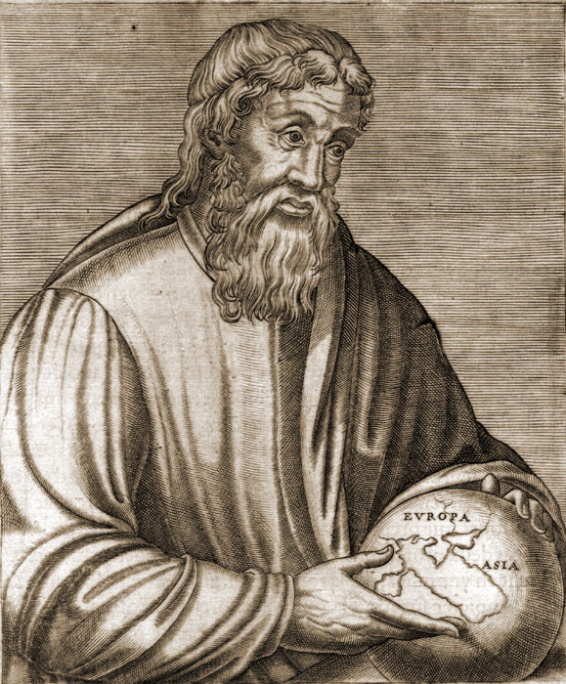
Strabo
born 63 BC or 64 BC, died ca. 24 AD), a Greek historian, geographer and philosopher
"Poseidonius conjectures that the names of these nations also are akin; for, says he, the people whom we call Syrians are by the Syrians themselves called Arameans."
(The Geography of Strabo, translated by Horace Leonard Jones and published in Vol. I of the Loeb Classical Library edition, 1917, Book I, Chapt. 2, 34)

Slide 6
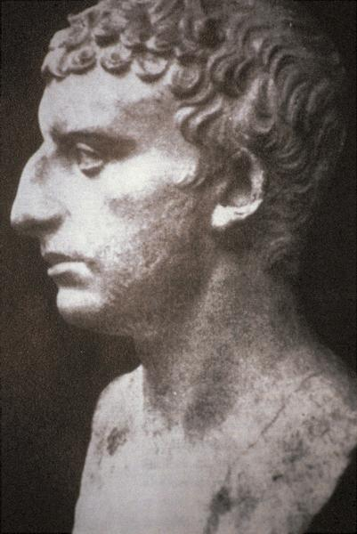



Titus Flavius Josephus
יוסף בן מתתיהו, Yohsef ben Matityahu, Titus Flavius Josephus (ca. 37 – ca. 100 C.E)
(Antiquities of the Jews, translated by William Whiston in 1737, Book I, Chapt. 6. Found also in Michael the Syrians Chronicle at the end aqefto in Edessan Aramaic)

Slide 7
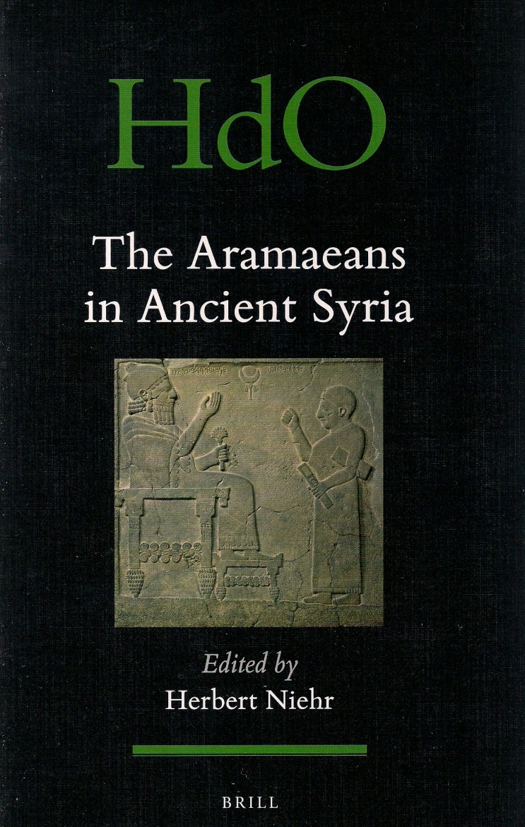
Titus Flavius Josefus
Adados and Azaelos (Bar Hadad and Hazael venerated as deites of the Arameans of the 1st century BCE mentioned by Flavius Josefus who in turn refers to the Greek historian and philosopher Nicholas of Damascus (born 64 BCE) as a source (see the paper of Herbert Niehr about Aramean religion from the book “The Arameans in ancient Syria” (2014)

Slide 8
Naaman the Aramean general
Naaman the general who lived at the time of the prophet Elisha (lived in the 9th century BCE)
Called Aramean 2 Kings 5:1-2 (PS King James version based on Septuagint anachronistically calls him Syrian instead of Aramean at a time in history where Arameans weren’t called Syrians yet in Greek nor in Syriac)
Naaman the Syrian in gospel of Luke 4:27
“Now Naaman, the general of the king of Aram, was a prominent man before his lord and respected, for through him had the Lord given victory to Aram; and the man was a great warrior, and he was a mezora. Now the Arameans went out in bands and captured from the land of Israel a young girl, who ministered to Naaman's wife.”
—Melachim II, 2 Kings 5:1-2
“There were also many lepers in Israel in the time of the prophet Elisha, and none of them was cleansed except Naaman the Syrian.” (Gospel of Luke 4:27. the gospel was written around 80-100 CE)

Slide 9
Naaman in different versions of NT in Edessan Aramaic
Naaman is usually called ”Syrian” (Σύρυς) in Gospel of Luke 4:27 in Greek and other Western languages such as Swedish and English. But called ”Aramean” just as in 2 kings 5:1 but called ”Aramean” (Armoyo/Oromoyo/Aramaya) in different Edessan Aramaic NT versions according George Kiraz except for in the Harklean version that was finished in 616 A.D.
Sinaiticus Syriacus: Armāyā “ The Aramean” (Ewangelion da-Mfarshe, Old Syriac in english)
Peshitta: Na‘mon Armāyā “Naaman the Aramean” (Mafaqto Fshitto)
Harklean: Na‘mon haw Sūryoyo “Naaman the Syrian” (Mafaqto d-Touma Harqeloyo) (this was based on the greek "Ναιμὰν ὁ Σύρος” (Naiman o Sύros)
(George.Anton Kiraz, Comparative Edition of the Syriac Gospels: Aligning the Sinaiticus,Curetonianus, Peshitta and Harklean Versions, III. Luke (E.J. Brill, Leiden, 1996, p. 71.)

Slide 10
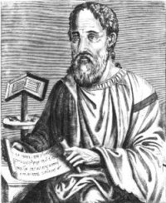
Eusebius of Ceaserea
Eusebius of Caesarea (c. 275 – May 30, 339), was a bishop of Caesarea in Roman province of Palestine:
“..and from Aram the Arameans, which are also called Syrians“
(Sebastian Brock, "Eusebius and Syriac Christianity," in Harold W. Attridge and Gohei Hata, eds., Eusebius, Christianity, and Judaism (Leiden 1992), p. 226. His book”Historia Ecclesiastica “ was translated at least in the 400s CE into Syriac)

Slide 11
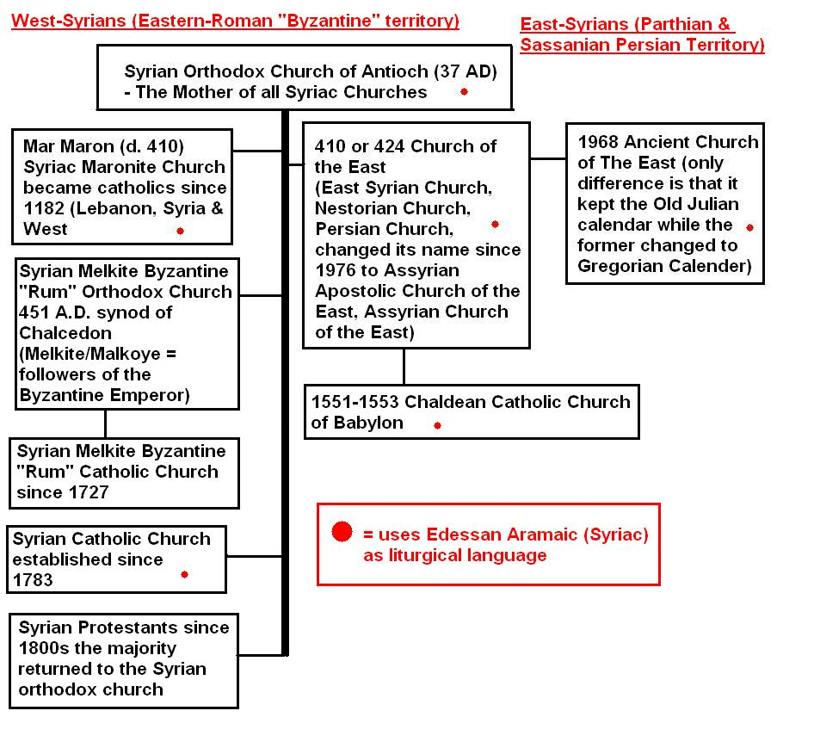
Syriac Churches

Slide 12
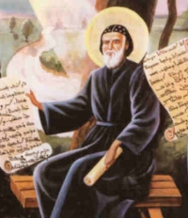
Since when was Mor Afrem called Suryoyo/Syrian?
Sozomenos
The biography about him
His supposed pagan father and the false non-existing idol Abizel/Amizel/Abnil etc ,
Biography ”Mor Afrem d-ith waw b-ghense Suryoyo””
Ephrem testifies of being brought up as a christian in his ”Hymns against Heresies” and ”Hymns on Virginity”

Slide 13
ܡܪܝ ܐܦܪܝܡ ܣܘܪܝܝܐ ܕܢܨܝܒܝܢ
S:t Ephrem the Syrian (306-373 AD):
ܡܢ ܥܒܪܝܶܐ ܘܐܪܡܝܶܐ ܐܦ ܡܢ ܥܝܪܶܐ
"From Hebrews and Arameans, and also from the Watchers..”
(The Nisibene Hymns, Nicene and Post-Nicene Fathers, Series II, Vol. XIII, translated by Rev. J.T. Sarsfield Stopford, B.A., Hymn 67., no.20.)

Slide 14
ܡܪܝ ܐܦܪܝܡ ܣܘܪܝܝܐ ܕܢܨܝܒܝܢ
S:t Ephrem the Syrian (306-373 AD)
ܫܒܚܘܗܝ ܒܣܘܟܝܗܘܢ ܐܳܪܳܡܳܝܶܐ.
"The Arameans praised him with their branches.“
(Edmund Beck, ed., Des Heiligen Ephraem des Syrers Hymnen de Virginitate, Louvain, 1962, CSCO Syr 223, p. 64)

Slide 15
ܡܪܝ ܐܦܪܝܡ ܣܘܪܝܝܐ ܕܢܨܝܒܝܢ
S:t Ephrem the Syrian (306-373 AD):
ܟܕ ܡܬܪܓܫ ܒܪܥܝܢܐ ܓܘܚܟܐ ܕܝܢ ܥܒܕ ܢܦܫܗ ܒܝܬ ܐܳܪܳܡܳܝܶܐ ܘܝܘܢܝܶܐ ܦܝܠܘܣܘܦܐ ܕܐܳܪܳܡܳܝܶܐ.
"But the Philosopher of the Arameans (i.e. Bardaisan) made himself a laughing-stock among Arameans and Greeks“
(S.Ephraim's Prose Refutations of Mani, Marcion and Bardaisan. Transcribed from the Palimpsest B.M. Add. 14623 by the late C. W. Mitchell, M.A., C.F., volume 2 (1921) pp.7)
[note: the translator rendered twice “Oromoye/Arameans" as "Syrians" here, see therefore the syriac text]

Slide 16
ܡܪܝ ܐܦܪܝܡ ܣܘܪܝܝܐ ܕܢܨܝܒܝܢ
S:t Ephrem the Syrian (306-373 AD)
...ܐܝܟ ܕܟܬܝܒ ܒܐܪܡܝܐ...
"They have combined and made from the word 'man,' as it is written in the Aramaic (the explanation) that this (word) refers to a (single) man, that is the Primal Man, the Father of the Five Shining Ones whom they call Ziwane (the Bright Ones)."
(St. Ephraim's Prose Refutations of Mani, Marcion and Bardaisan. Transcribed from the Palimpsest B.M. Add. 14623 by C. W. MITCHELL, M.A., volume 1 (1912), p. 122)
[note: Mitchell rendered "Aramaic" as "Syriac" here, see therefore the original syriac text, where it is "Aramaic"]

Slide 17
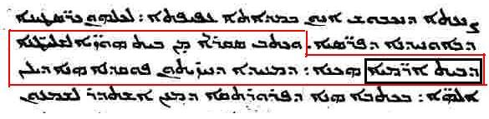
ܡܪܝ ܫܡܥܘܢ ܒܪ ܨܒܥܐ
Mar Shemun Bar Sabba’e (d.344) catholicos bishop of Seleucia-Ctesiphon
(Syriac Manuscripts from the Vatican Library; Volume 1, VatSyr. 161, number 3. Martyrdom of St. Simeon (Symeon bar Sabba‘e), Bishop of Seleucia and Ctesiphon, and his companions. Fol. 20a)

Slide 18
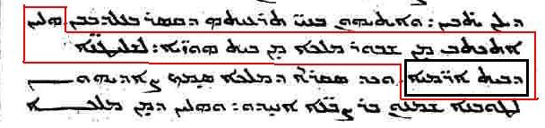
ܡܪܝ ܫܡܥܘܢ ܒܪ ܨܒܥܐ
Mar Shem’un Bar Sabba’e (d.344) catholicos bishop of Seleucia-Ctesiphon
(Syriac Manuscripts from the Vatican Library; Volume 1, VatSyr. 161, number 3. Martyrdom of St. Simeon (Symeon bar Sabba‘e), Bishop of Seleucia and Ctesiphon, and his companions. Fol. 20a)

Slide 19
ܡܪܝ ܫܡܥܘܢ ܒܪ ܨܒܥܐ
Mar Shemun Bar Sabba’e (d.344) catholicos bishop of Seleucia-Ctesiphon In the martyrdom of Simon Bar Sabbae and his companions we read:
"And from Khuzestan [ancient Elam] he [King Shapur II] wrote an edict to the rulers of Beth Aramaye"
"These (things) were written by King Shapur [II; 309-379 AD] from Khuzestan to the rulers of Beth Aramaye.“
(Syriac Manuscripts from the Vatican Library; Volume 1, VatSyr. 161, number 3. Martyrdom of St. Simeon (Symeon bar Sabba‘e), Bishop of Seleucia and Ctesiphon, and his companions. Fol. 20a)

Slide 20
When did the Arameans begin to use the Greek exonym Surioi as Suryoyo/Suryoye?
Rabbula of Edessas (d. 435 CE) biography about him by his disciple
John Rufus (Yuhanon Beth Rufine) 400s CE
Jacob of Serugh (451-521 CE)

Slide 21
ܬܠܡܝܕܐ ܕܡܪܝ ܪܒܘܠܐ ܕܐܘܪܗܝ ܥܠ ܡܠܦܢܐ ܕܝܠܗ ܒܬܪ ܡܢ ܫܘܢܝܗ
The biography of Rabbula of Edessa (d. 435) by his disciple right after his death.
ܐܪܒܥܝܢ ܘܫܶܬ ܐܓܪܳܢ ܕܟܬܰܒ ܠܟܗܢܶܐ ܘܠܡܠܟܶܐ ܘܠܪܘܪܒܢܶܐ ܘܠܕܝܪܝܶܐ: ܥܡܠܢܢ ܚܢܢ ܕܢܦܫܩ ܐܢܘܢ ܡܢ ܝܘܢܝܐ ܠܣܘܪܝܝܐ.
”He wrote 46 letters to preasts , kings, leaders, and monks, we worked on translating them from greek to syriac.”
(Published by the Chaldean Catholic priest Paul Bedjan in Acta Martyrum et sanctorum syriace , Vol IV, Paris 1894, page 440)

Slide 22
ܬܠܡܝܕܐ ܕܡܪܝ ܪܒܘܠܐ ܕܐܘܪܗܝ ܥܠ ܡܠܦܢܐ ܕܝܠܗ ܒܬܪ ܡܢ ܫܘܢܝܗ
The biography of Rabbula of Edessa (d. 435) by his disciple right after his death.
ܦܫܩ ܕܝܢ ܕܝܬܝܩܐ ܚܕܬܐ ܡܢ ܝܘܢܝܐ ܠܣܘܪܝܝܐ..
”(He) translated the New Testament from Greek to Syriac…”
(Pulished by the Chaldean Catholic preast Paul Bedjan in Acta Martyrum et sanctorum syriace , Vol IV, Paris 1894, page 410)

Slide 23
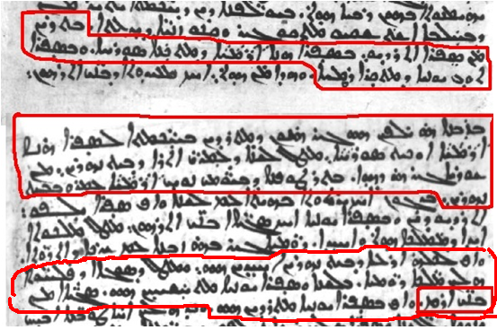
ܝܘܚܢܢ ܒܝܬ ܪܘܦܝܢܐ (ܪܘܦܘܣ)
John Rufus (5th -6th century) disciple of Peter the Iberian (417-491)

Slide 24
ܝܘܚܢܢ ܒܝܬ ܪܘܦܝܢܐ (ܪܘܦܘܣ)
John Rufus (5th century) disciple of Peter the Iberian (417-491)
"They were instructed in both of the writings: in this Aramaic writing that is named Syriac and also in the Greek writing that is called Roman…”
“For at that time those who were instructed in wisdom were learning this Aramaic writing, namely Syriac, because it was the language of those who dwell in Mesopotamia from the beginning. After the Flood that was in the days of Noah the Arameans dwelled in Mesopotamia (Beth Nahrin…”
“Many of the sons of Aram were instructed in the Greek writing.“
(Syriac Manuscripts from the Vatican Library; Volume 1, VatSyr 37: Life of St. Abhai, Bishop of Nicea. Fol. 157a-157b)

Slide 25
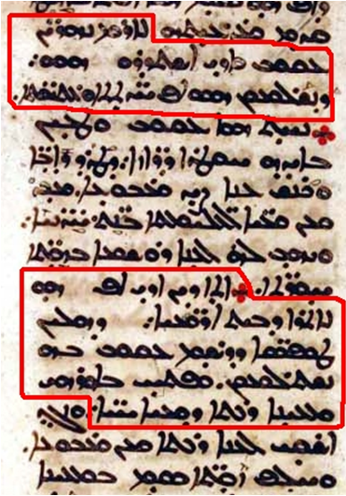
ܡܪܝ ܝܥܩܘܒ ܕܣܪܘܓ
Jacob of Serugh (451-521)

Slide 26
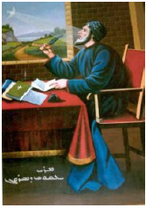
ܡܪܝ ܝܥܩܘܒ ܕܣܪܘܓ
Jacob of Serugh (451-521)
"[The Biblical Patriarch] Jacob and [the apostle] Addai were sent to Aram-Nahrin, so that they would fulfill both the New and Old (Testament words)."
"Addai himself, too, came to the land of Beth Aramaye, so that these symbols drawn by Jacob would be fulfilled through him. And (so) in Edessa he opened up a big fountain of living waters."
(Syriac Manuscripts from the Vatican Library: Volume I, VatSyr. 117 number 108. On Addai the Apostle and Abgar the King of Edessa, Fol. 270a)

Slide 27
ܡܪܝ ܝܥܩܘܒ ܕܣܪܘܓ
Jacob of Serugh (451-521) wrote a madrosho about Ephrem the Syrian (306-373)
ܗܢܐ ܕܗܘܐ ܟܠܝܐ ܠܟܠܗ ܐܪܡܝܘܬܐ ܘܒܗ ܐܬܩܪܒܬ ܬܡܛܐ ܠܫܘܦܪܶܐ ܪܘܚܢܝܶܐ.
ܗܢܐ ܕܗܘܐ ܪܗܝܛܪܐ ܪܒܐ ܒܝܬ ܣܘܪܝܝܶܐ.
"He who became a crown for all Arameans, (and) by him we have been brought close to spiritual beauty. He who became a great orator amongst the Syrians"
(Ed. Joseph Amar, A Metrical Homily on Holy Mar Ephrem by Mar Jacob of Serugh, Patrologia Orientalis 47,1, page 155)
(Published by the Chaldean Catholic priest Paul Bedjan in Acta Martyrum et sanctorum syriace , Vol III , Paris 1892 p. 677)

Slide 28
ܡܪܝ ܝܥܩܘܒ ܕܣܪܘܓ
Jacob of Serugh (451-521) In his Homily on Addai, the Apostle and King Abgar of Edessa:
ܥܕܬܐ ܒܪܬ ܐܳܪܳܡܳܝܶܐ
"This one brought the glorious garments from the house of the Father and bathed and embellished the daughter (the church) of the Arameans when she was taken [as wife]."
(Syriac Manuscripts from the Vatican Library: Volume 1, VatSyr. 117 number 108. On Addai the Apostle and Abgar the King of Edessa. Fol. 268b)

Slide 29
ܡܪܝ ܝܥܩܘܒ ܕܣܪܘܓ
Jacob of Serugh (451-521) about the city of Edessa:
ܐܘܪܗܝ ܒܪܬ ܐܳܪܳܡܳܝܶܐ...
“Edessa the daughter of the Arameans, albeit aloof, heard his lore"
(Words, Texts And Concepts Cruising The Mediterranean Sea: Studies On The Sources, Contents And Influences Of Islamic Civilization And Arabic Philosophy And Science : Dedicated To Gerhard Endress On His Sixty Peter Bruns' Ein Memra des Jakob von Serug Auf Edessa und Jerusalem, p 459)

Slide 30
ܡܪܝ ܝܥܩܘܒ ܕܣܪܘܓ
....ܐܒܓܪ, ܒܪ ܐܳܪܳܡܳܝܶܐ…,
"Two precious pearls, which were an ornament for the bride of my lord Abgar, the son of (the) Arameans“
"The darkness of the world and the blackness of Abgar, son of (the) Arameans, the world of darkness became light through Abgar in Christ." (In his Homily on Edessa and Jerusalem:)
(A Homily on Guria and Shamuna Composed by Mar Jacob, Text tr. A. Roberts and J. Donaldson (eds.), Ante-Nicene Fathers, vol. 8, 1886)
(See Syriac Manuscripts from the Vatican Library: Volume 1, VatSyr. 117, number 224:On Shmona and Gurya. Fol. 551a, p. 1099)
(Words, Texts And Concepts Cruising The Mediterranean Sea: Studies On The Sources, Contents And Influences Of Islamic Civilization And Arabic Philosophy And Science : Dedicated To Gerhard Endress On His Sixty Peter Bruns' Ein Memra des Jakob von Serug Auf Edessa und Jerusalem, p. 546)

Slide 31
ܡܪܝ ܝܥܩܘܒ ܕܣܪܘܓ
Jacob of Serugh (451-521)
”ܝܒܝܒ ܘܝ ܓܝܪ ܥܒܪ̈ܝܬܐ ܒܦܠܓܝܗܝܢ ܘܗܪܟܐ ܡܫܒܚܝܢ ܐܪ̈ܡܝܬܐ ܒܡܕ̈ܪܫܝܗܝܢ”
”Yabib way ger ’Ebroyotho ba flageyhen u horko mshabhen Oromoyotho
b-madroshayhen”
“and after the model of the Hebrew women he taught the Aramaean women to give praise with their madroshe (homilior);
(Ed. Joseph Amar, A Metrical Homily on Holy Mar Ephrem by Mar Jacob of Serugh, Patrologia Orientalis 47,1, p. 46)

Slide 32
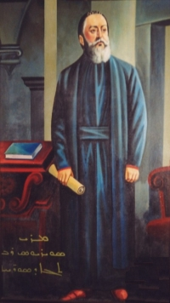
ܡܪܝ ܣܘܪܝܘܣ ܪܒܐ ܕܐܢܛܝܘܟܝܐ
Severius of Antioch
(c. 465-538) :
ܗܘ ܗܟܘܬ ܐܦ ܚܢܢ ܐܪ̈̈̈̈ܡܝܐ ܐܘܟܝܬ ܣܘܪ̈ܝܝܐ
(Maurice Brière, Les Homiliae Cathedrales de Sévère d'Antioche Traduction Syriaque de Jacques d'Edesse (Suite) Homelies CXX A CXXV in F. Graffin, Patrologia Orientalis Tome XXIX-Fasicule 1, p. 196; Jacob of Edessa translated Severius of Antiochs homilior into Syriac from Greek)

Slide 33

ܡܪܝ ܝܥܩܘܒ ܕܐܘܪܗܝ
Jacob of Edessa (ca 633-708)
ܗܘ ܗܟܘܬ ܐܦ ܚܢܢ ܐܳܪܳܡܳܝܶܐ ܐܘܟܝܬ ܣܘܪܝܝܶܐ...
"It is in this way we (the) Arameans, that is to say Syrians ..."
(Maurice Brière, Les Homiliae Cathedrales de Sévère d'Antioche Traduction Syriaque de Jacques d'Edesse (Suite) Homelies CXX A CXXV in F. Graffin, Patrologia Orientalis Tome XXIX-Fasicule 1, p. 196 196;Jacob of Edessa translated Severius of Antiochs homilior into Syriac from Greek)

Slide 34
ܡܪܝ ܝܥܩܘܒ ܕܐܘܪܗܝ
Jacob of Edessa (ca 633-708) in his book "The Six Days":
ܗܟܢܐ ܕܡܝܐ ܕܐܫܬܡܗܬ ܬܝܡܢܐ ܕܐܦ ܠܘܬܢ ܐܳܪܳܡܳܝܶܐ. ܗܝ ܕܝܢ ܕܓܪܒܝܐ ܠܐ ܝܕܝܥܐ ܠܢ ܡܛܠ ܡܢܐ ܗܟܢܐ ܐܬܩܪܝܬ ܡܢ ܥܬܝܩܶܐ ܒܢܝ ܐܪܐܡ.
"It appears that the south was so named also by us Arameans. But as for the north, it is not known to us why it was called (such) by the ancient sons of Aram."
(Schtoth Yaume: Hexaemeron, Die Schöpfungslehre des Jakob von Edessa (+708). Nach der Estrangelo Handschrift, die 839 n. Chr. geschrieben wurde; abgeschrieben von Erzbischof Julius Yeshu. Cicek, Verlag Bar Hebräus, Losser-Holland 1985, p. 60)

Slide 35
ܡܪܝ ܝܥܩܘܒ ܕܐܘܪܗܝ
Jacob of Edessa (ca 633-708)
ܬܠܬܐ ܓܒܪܶܐ ܗܘܘ ܒܠܫܢܐ ܗܢܐ ܕܣܘܪܝܝܶܐ ܐܘܟܝܬ ܕܳܐܳܪܳܡܳܝܶܐ: ܕܡܫܬܡܗܝܢ ܒܫܡܐ ܗܢܐ ܐܝܣܚܩ ܐܟܡܐ ܕܝܠܦܬ ܡܢ ܓܒܪܶܐ ܥܬܝܩܶܐ ܕܩܕܡܝ…
”In the language of the Syrians i.e the Arameans there were three men known under the name of Isaac….”
(Cronica Minora, Paris 1903, p. 293)

Slide 36
ܡܪܝ ܝܥܩܘܒ ܕܐܘܪܗܝ
Jacob of Edessa (ca 633-708) in his book "The Six Days":
…”ܒܡܰܡܠܠܰܢ ܕܶܝܢ ܐܳܪܳܡܳܝܳܐ”
"The bees cast the fructifying seed of their nature into it; thus it is according to the manner of speaking in our Aramaic tongue."
(Schtoth Yaume: Hexaemeron, Die Schöpfungslehre des Jakob von Edessa +708). Nach der Estrangelo Handschrift, die 839 n. Chr. geschrieben wurde; abgeschrieben von Erzbischof J.J. Cicek, Verlag Bar Hebräus, Losser-Holland 1985, p. 171)

Slide 37
ܡܪܝ ܕܝܘܢܢܘܣܝܘܣ ܬܠܡܚܪܝܐ
Syriac Orthodox patriarch Mor Dionysios of Tell Mahre (patriarch between 817-845)
ܘܡܢ ܗܪܟܐ ܫܪܝܘ ܒܢܝ ܗܓܪ ܠܡܫܥܒܕܘ ܠܒܢܝ ܐܪܡ
ܒܫܘܥܒܕܐ ܡܨܪܝܐ.
“From now on the descendants of Hagar (The Arab muslims) began to enslave the sons of Aram (The Arameans) an Egyptian slavery”
(Jean Baptiste Chabot, Quatriéme Partie de la Chronique Syriaque de Denys de Tell Mahré Texte Syrlaque.P.11.)

Slide 38
ܡܘܫܐ ܒܪ ܟܐܦܐ
Mushe bar Kifo (813-903) says in his book "The Six Days":
ܬܘܒ ܕܝܢ ܐܡܪ ܦܝܠܠܘܟܣܝܢܐ ܕܗܕܐ ܡܦܩܬܐ ܦܫܝܛܬܐ ܕܐܬܝܒܠܬ ܠܠܫܢܐ ܕܝܠܢ ܐܪܡܝܐ ܡܬܐܡܪܐ ܕܐܝܬܝܗ̇ ܕܐܩܘܠܐ ܘܕܣܘܡܟܘܣ.
”Mor Philoxenus said also that the translation of the Bible called “Peshitta" which was translated into our language, the Aramaic, is the work of Aquilas and Symachus. ”
(Patriarch A. Barsaum, The Syrian Orthodox Church of Antioch: Its Name and History, published by the syriac organizations in Middle Europe and Sweden 1983, p. 17)

Slide 39
ܒܪ ܒܗܠܘܠ ܣܘܪܝܝܐ ܡܕܢܚܝܐ
Abu al-Hasan bar Bahlul († 963) East-Syrian (Nestorian) lexicographer from Baghdad:
ܡܢ ܩܕܝܡ ܣܘܪܝܝܐ ܐܪܡܝܐ ܡܬܩܪܝܢ ܗܘܘ
”The Syrians were formerly called Arameans”
(Rubens Duval (ed.), Lexicon Syriacum, Paris, 1888-1901, p. 1323-1324)

Slide 40
ܐܠܝܐ ܒܪ ܫܢܢܝܐ ܕܢܨܝܒܝܢ ܣܘܪܝܝܐ ܡܕܢܚܝܐ ܢܣܛܘܪܝܢܐ
Mar Elia bar Shenaya East-Syrian (Nestorian) bishop of Nisibin (975-1049). About Al-hajjaj ibn Yusuf:
ܘܦܩܕ ܚܔܔ ܕܠܐ ܢܩܘܡ ܪܝܫܐ ܠܟܪܝܛܝܢܐ. ܘܦܫܬ ܥܕܬܐ ܕܒܝܬ ܐܪܡܝܐ ܕܠܐ ܪܝܫܐ ܥܕܡܐ ܠܡܘܬܗ ܕܚܔܔ.
”Al-Hajjaj gave order so that the Christians shall not install any churchleader, and the church of the Arameans' land remained without an overhead until the death of Hajjaj.”
(Elie, Enque de nisibe chronologie, p.142)

Slide 41
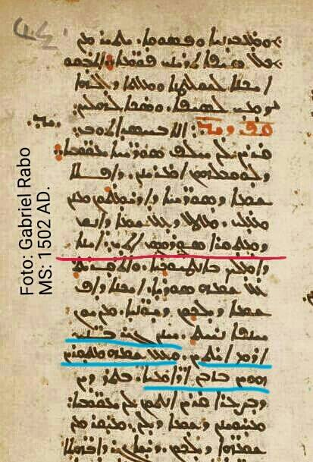
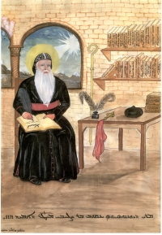
ܡܪܝ ܕܝܘܢܢܘܣܝܘܣ ܝܥܩܘܒ ܒܪ ܨܠܝܒܝ

Slide 42
ܡܪܝ ܕܝܘܢܢܘܣܝܘܣ ܝܥܩܘܒ ܒܪ ܨܠܝܒܝ
Syrian Orthodox Patriarch Mor Dionysios Jacob Bar Salibi (d. 1171):
ܐܠܐ ܒܚܣܕܐ ܩܪܝܢ ܠܢ (ܝܘܢܝܶܐ) ܚܠܦ ܣܘܪܝܝܶܐ ܝܥܩܘܒܝܶܐ ܕܠܘܩܒܠܗܘܢ ܐܡܪܝܢܢ: ܕܐܦܠܐ ܫܡܐ ܕܣܘܪܝܝܶܐ ܕܐܪܝܡܬܘܢ ܡܢܢ ܡܥܠܝ: …...ܚܢܢ ܓܝܪ ܒܢܝ ܐܪܡ ܐܝܬܝܢ:ܘܥܠ ܫܡܗ ܡܬܩܪܝܢ ܗܘܝܢ ܒܙܒܢ ܐܳܪܳܡܳܝܶܐ.
(Bar Salibi, Kthobo d-oru`utho. Fosuqo 14 luqbal yawnoye)

Slide 43

ܡܪܝ ܕܝܘܢܢܘܣܝܘܣ ܝܥܩܘܒ ܒܪ ܨܠܝܒܝ
"Because of hatred they (the Greeks) call us Jacobites instead of Syrians and we answer and say that the name Syrian by which you do not call us anymore does not rank before the honorable name...however we are the sons (descendants ) of Aram and from his name we were called in ancient times by the name Arameans.“
(Bar Salibi, Kthobo d-oru`utho. Fosuqo 14 luqbal yawnoye)
(Chaldean Bishop Jacob Eugin Manna, Aramaic (Chaldean) -Arabic Dictionary, Babel Center Publications. Beirut 1915, p. 11-21)

Slide 44
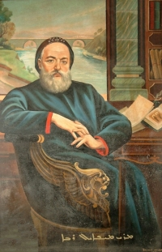

ܡܪܝ ܡܝܟܐܝܠ ܪܒܐ
Syrian Orthodox patriarch Michael the Syrian (The Great) (1126-1199) (patriarch 1166-1199) ”Edessa-Aleppo Codex 1598, by Mikhoel Bar Barsaaumo of Urbish:
”...The kingdoms which have been established in antiquity by our race, (that of) the Arameans, namely the sons (descendants) of Aram, who were called Syrians…“
(Jean-Baptiste Chabot, Chronique de Michel le Syrien Patriarche Jacobite d'Antioche (1166-1199) Tome I-II-III (French) and Tome IV (Syriac), Paris, 1899 p. 748, appendice II, see also Gabriel Yalgins 2006 edition page 815)

Slide 45
ܫܠܝܡܘܢ ܕܦܪܬ ܡܝܫܢ ܐܘܟܝܬ ܕܒܨܪܐ
East-Syrian (Nestorian) Metropolitan of Basra
(Prat Maishan) (d. 1240) in his “The Book of the Bee”:
ܡܛܠ ܕܠܝܬ ܗܘܐ ܠܐܪ̈ܡܝܐ ܐܘܟܝܬ ܣܘܪ̈ܝܝܐ ܫܘܬܦܘܬܐ ܒܕܡܗ ܕܡܫܝܚܐ.
“for the Arameans that is to say the Syrians had no part in (the shedding of) Christ's blood”
(The Book of the Bee, edited and translated by Earnest A. Wallis Budge, M. A. [Oxford, the Clarendon Press] 1886, chapt. 23, p. 99)

Slide 46
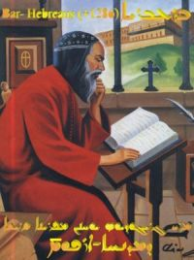
ܡܪܝ ܓܪܝܓܘܪܝܘܣ ܝܘܚܢܢ ܒܪ ܥܒܪܝܐ
Syrian Orthodox Maferyono Mor Gregorios Bar Hebraeus (Bar ’Ebroyo, Ibn al-’Ibri, Gregory Abu Al-Faraj) (d. 1286)
ܒܟܰܠܕܳܝܽܘܬܐ ܐܰܪܡܳܝܬܐ ܕܠܳܥܽܘܙܳܝܳܐ ܠܐ ܚܰܒܶܠܬܢܝ. ܘܠܣܽܘܪܝܳܝܽܘܬܐ ܐܳܪܳܡܳܝܬܐ ܕܟܳܪܽܘܙܳܝܳܐ ܝܒܠܬܢܝ.
"You have not corrupted me in the barbaric, pagan astrology, but [instead] you have brought me to the eloquent Aramean-Syriac nation."
(Bar Hebräus Ausschnitt aus seinem Vorwort des Buches „Kthobo d-Semhe“ [Buch der Strahlen]. Grammar of the Syriac Language by Bar Hebraeus. Schweden 1983, p. 2)
(Buch der Strahlen die groessere Grammatik des Barhebraeus : Uebersetzung nach einem kritisch berichtigten Texte mit textkritischem Apparat und einem Anhang zur Terminologie. Leipzig : O. Harrassowitz, 1907-1913, preface)

Slide 47
ܡܪܝ ܓܪܝܓܘܪܝܘܣ ܝܘܚܢܢ ܒܪ ܥܒܪܝܐ
ܠܐ ܨܒܝܢ ܐܳܪ̈ܡܳܝܶܐ ܕܢܬܚܠܛܘܢ ܥܡ ܐܰܪ̈ܡܳܝܶܐ.
“The Arameans don't want to mix with the pagans.“
(R. Payne Smith, Thesaurus syriacus, Oxford 1879-1901, Volume 1, column 388)

Slide 48
ܩܫܝܫܐ ܝܫܘܥ ܒܪ ܕܘܝܕ ܕܗܘ ܝܫܘܥ ܒܪ ܟܝܠܐ ܕܚܐܚ ܩܣܛܬܪܐ ܕܛܘܪܥܒܕܝܢ
Syriac Orthodox priest Yeshu bar David also known as
Yeshu bar Kilo of Hah in Tur ’Abdin) (d. 1309) in his 9th letter to a priest:
ܠܟܗܢܐ ܕܐܬܓܒܝ ܫܪܓܐ ܠܥܡܐ ܐܪܡܝܐ
"to the priest who was elected as light to the Aramean people“
(Bar Kilo I, Bar Chacaco II, David Beit-Rabban III, edited by Syrian Catholic priest Ishok Bar Armalto, Beirut 1928, p. 22)
)ܐܓܪ̈ܬܐ ܕܝܫܘܥ ܒܪ ܕܘܝܕ ܩܫܝܫܐ ܕܡܬܝܕܥ ܒܪ ܟܝܠܐ ܕܡܢ ܚܐܚ ܩܣܛܪܐ ܕܒܛܘܪܥܒܕܝܢ. ܐܬܚܬܡ̈ܝ ܒܝܕ ܐܝܣܚܩ ܒܪ ܐܪܡܠܬܐ ܩܫܝܫܐ ܣܘܪܝܝܐ ܩܬܘܠܝܩܝܐ ܫܢܬ ܐܨܟܚ. ܕܦܐ ܠܐ).

Slide 49
ܩܫܝܫܐ ܝܫܘܥ ܒܪ ܕܘܝܕ ܕܗܘ ܝܫܘܥ ܒܪ ܟܝܠܐ ܕܚܐܚ ܩܣܛܬܪܐ ܕܛܘܪܥܒܕܝܢ
In his 13th letter to a deacon:
ܗܘ ܒܢܘܗܪܐ ܐܟ ܚܟܝܡܐ܆ ܘܗܢܐ ܒܣܝܦܐ ܩܫܝܘܬܗ. ܗܟܢ ܒܫܘܦܪܐ ܕܝܕܥܬܐ܆ ܣܚܦܬ ܠܒܝܫܐ ܘܠܡܨܝܕܬܗ. ܗܬܘܣ ܟܠܗ ܕܳܐܪܳܡܳܝܶܐ.
"in this way in the beauty of wisdom you have overthrown evil and its snare. The whole people of the Arameans sees that he refreshs his thirst.“
]ܗ ܣܽܘܪ̈ܝܳܝܐ: ܢܽܘܗܳܪܳܐ ܕܐܝܣܚܩ ܒܪ ܐܪܡܠܬܐ[܆ ܚܐܪ ܕܰܬܦܰܝܶܓ ܨܰܗܝܶܗ
(Bar Kilo I, Bar Chacaco II, David Beit-Rabban III, edited by Syrian Catholic priest Ishok Bar Armalto, Beirut 1928, p. 31)
(ܐܓܪ̈ܬܐ ܕܝܫܘܥ ܒܪ ܕܘܝܕ ܩܫܝܫܐ ܕܡܬܝܕܥ ܒܪ ܟܝܠܐ ܕܡܢ ܚܐܚ ܩܣܛܪܐ ܕܒܛܘܪܥܒܕܝܢ. ܐܬܚܬܡ̈ܝ ܒܝܕ ܐܝܣܚܩ ܒܪ ܐܪܡܠܬܐ ܩܫܝܫܐ ܣܘܪܝܝܐ ܩܬܘܠܝܩܝܐ ܫܢܬ ܐܨܟܚ. ܕܦܐ ܠܐ).

Slide 50
How long have we claimed that we abandoned the Aramean name and replaced it with Suryoye/Suryaye?

Slide 51
ܐܘܡܬܢܘܝܬܐ
Nationalism

Slide 52
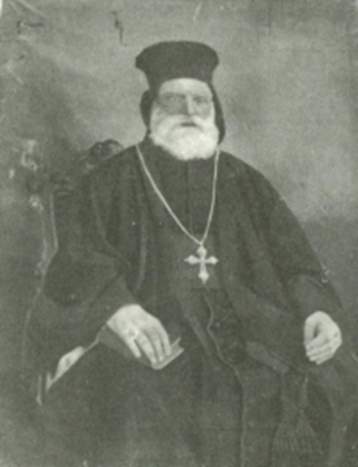
ܡܪܝ ܩܠܝܡܝܣ ܝܘܣܦ ܕܘܝܕ
Clemens Joseph David Syriac Catholic archbishop of Damascus Syria 1829-1890
“And when the Arameans converted to Christianity they forgot about their (Aramean) name, and were called Syrians distinguishing them from the heathen Arameans.”
(preface of Grammaire de la langue Arameenne, Deuxième Edition, Mosul, 1896) .

Slide 53
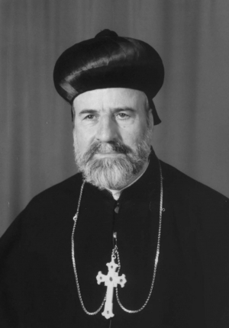
ܡܪܝ ܣܘܪܝܘܣ ܐܣܚܩ ܣܟܐ
Mor Severius Ishak Saka (1931-2011). Syriac Orthodox patriarchal vicar of Qaraqosh (Iraq)
“Bishop Ishak Saka (12) borrowed literary some sentences from the preface of Augin Manna such as ” And so the word Syriac and Syrian became Christian or synonymous to it until this day” and he extracts from the theory of Manna/QUATREMERE “ The name Syrian was never ever used as a term of nation but only as a name of religion”. This is of course wrong and contradict what he wrote in the beginning of his paper “The Syrians were called Arameans, after Aram, before the Christ”
(Henri Bedros Kifa ” Why St Ephrem was called “The Syrian”? See also DICTIONARY OF BISHOP MANNA, p 17-QUATREMERE , Memoire sur les Nabatéens PARIS 1831.p 95Bishop Ishak Saka, My Syrian Church, Damascus 1985, p 23

Slide 54
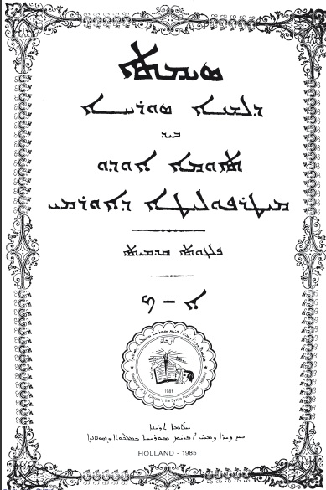
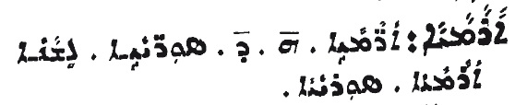
ܡܪܝ ܬܐܘܡܐ ܐܘܕܘ ܡܝܛܪܘܦܘܠܝܛܐ ܟܠܕܝܐ ܕܐܘܪܡܝ
Chaldean Catholic Metropolitan of Urmia (Iran) Mar Touma Audo (1853-1917).
His dictionary ”Simta D-Lishana Suryaya” (1897) (Treasure of the Syriac Language by Thomas Audo Metropolitan of Urmia, Part I-II., ND Verlag Bar Hebräus, Losser-Holland 1985, preface p. 49; can be found on the same page regardless of edition ,1897 Mosul, 1978 Chicago, 1979 Stockholm etc) :

Slide 55
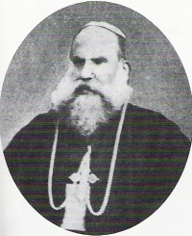
ܡܪܝ ܐܣܪܐܝܠ ܐܘܕܘ
Mar Israel Audo (1859-1947) Chaldean Catholic bishop of Mardin the brother of Mar Touma Audo, wrote a book about Seyfo in Aramaic (Syriac). The title is:
"The Book on the persecutions of the christian Armeniens and Arameans of Mardin, Diyarbakir, Séert, Djézireh-Ibn-Omar and Nisibis which took place in the year 1915".
"About the persecution of the (Kaldaye) Chaldean Aramaye, that is to say the Suryaye"
(He uses in general mostly Aramaye/Arameans in the entire book)
(History of the persecution of the Christians of Mardin, Amid, Seert, Gozarto, and Nisibis which took place in 1915, published in Sweden, 2005 )
(ibid. p. 19)

Slide 56
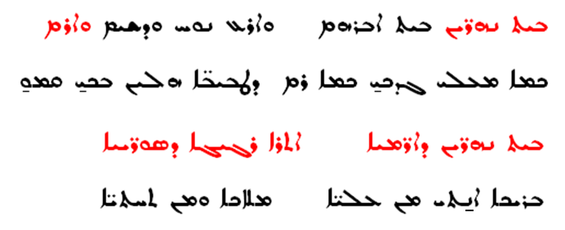
ܡܪܝ ܐܓܢܛܐܝܘܣ ܐܦܪܝܡ ܩܕܡܝܐ ܒܝܬ ܒܪܨܘܡ
Syrian Orthodox patriarch Mor Ignatius Afrem I Barsoum (1887-1957) wrote a poem about ”Beth Nahrin”.
(About Beth Nahrin (Mesopotamia) written in Homs (Syria) on the 20th of May 1943 published in “Sefro Suryoyo” [The Syriac Writing] in Aleppo (Syria) in 1947)

Slide 57
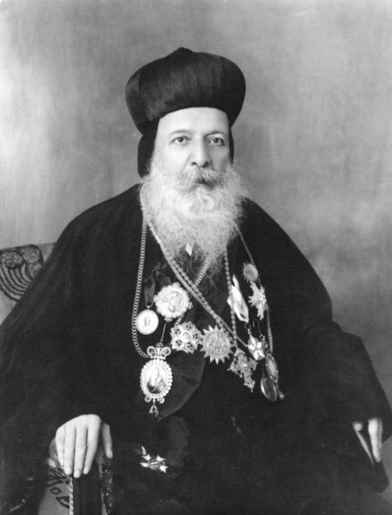
ܡܪܝ ܐܓܢܛܐܝܘܣ ܐܦܪܝܡ ܩܕܡܝܐ ܒܝܬ ܒܪܨܘܡ
"Beth Nahrin, Beth (land of) Abraham, the land of Noah, Shem and Aram"
"Beth Nahrin of the Arameans, the beloved place of the Syriacs“
(About Beth Nahrin (Mesopotamia) written in Homs (Syria) on the 20th of May 1943 published in “Sefro Suryoyo” [The Syriac Writing] in Aleppo (Syria) in 1947, p. 43 and 44)

Slide 58
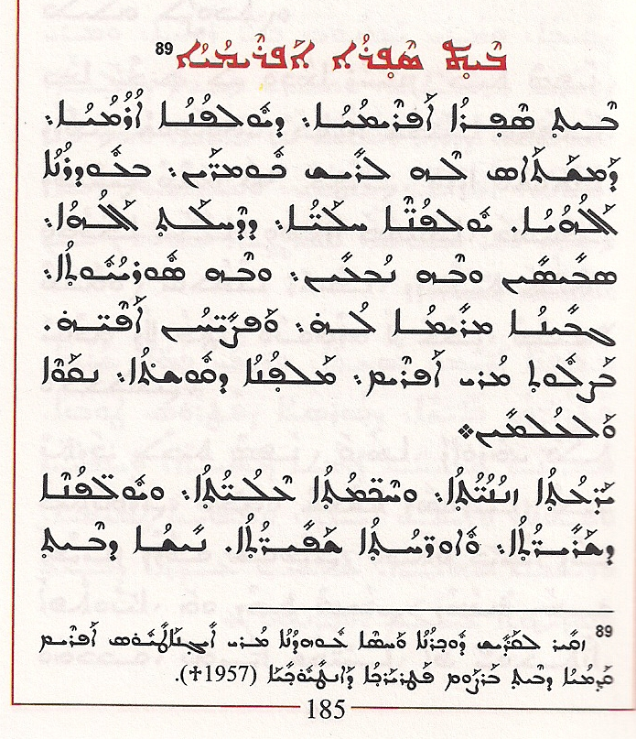
ܡܪܝ ܐܓܢܛܐܝܘܣ ܐܦܪܝܡ ܩܕܡܝܐ ܒܝܬ ܒܪܨܘܡ

Slide 59
ܡܪܝ ܐܓܢܛܐܝܘܣ ܐܦܪܝܡ ܩܕܡܝܐ ܒܝܬ ܒܪܨܘܡ
ܕܢܫܬܡܗܘܢ ܫܒܪܶܐ ܥܡܝܕܶܐ ܒܫܡܗܶܐ ܕܩܕܝܫܶܐ ܘܕܣܗܕܶܐ: ܐܟ ܡܫܠܡܢܘܬܐ ܥܬܝܩܬܐ ܕܐܒܗܝܢ ܐܳܪܳܡܳܝܶܐ ܣܘܪ̈ܝܝܶܐ ܬܪ̈ܝܨܝ ܫܘܒܚܐ: ܐܦ ܒܫܡܗܶܐ ܣܘܪ̈ܝܝܶܐ ܐܟ ܐܒܗܝܗܘܢ܆ ܣܓܝ ܘܠܝܐ ܗܝ ܘܡܩܠܣܐ. ܘܠܘ ܒܫܡܗܶܐ ܕܢܘܟܪܝܶܝܢ ܠܕܪܬܢ ܟܗܢܝܳܬܳܐ ܘܠܡܫܠܡܢܘܬܐ ܕܓܢܣܢ ܩܪܝܚܐ ܘܢܨܝܚܐ.
"The baptizands should be baptized in the names of the Saints and Martyrs according to the tradition of our venerably aramean syrian-orthodox church fathers….“
(Patriarch Aphrem Barsaum: The Sacrament of Holy Bastism and Matrimony. According to the Ancient Rite of the Syrian Orthodox Church of Antioch, Losser-Holland, second edition, 1989, p. 10)

Slide 60
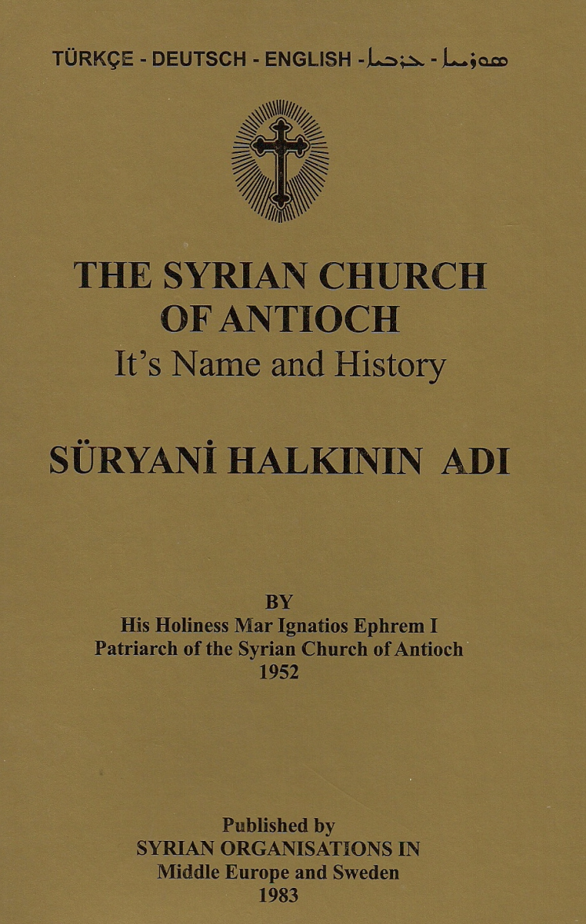
ܡܪܝ ܐܓܢܐܛܝܘܣ ܐܦܪܝܡ ܩܕܡܝܐ ܒܪܨܘܡ

Slide 61
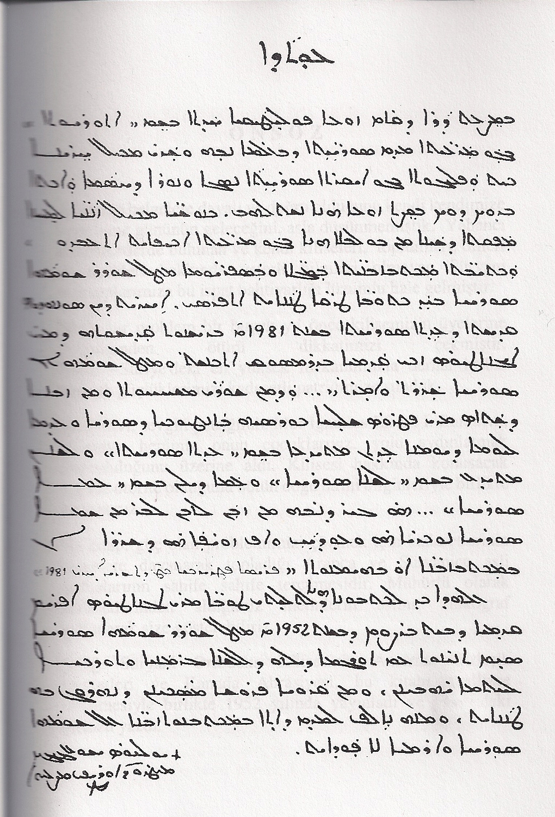
ܡܪܝ ܐܓܢܐܛܝܘܣ ܐܦܪܝܡ ܩܕܡܝܐ ܒܪܨܘܡ

Slide 62
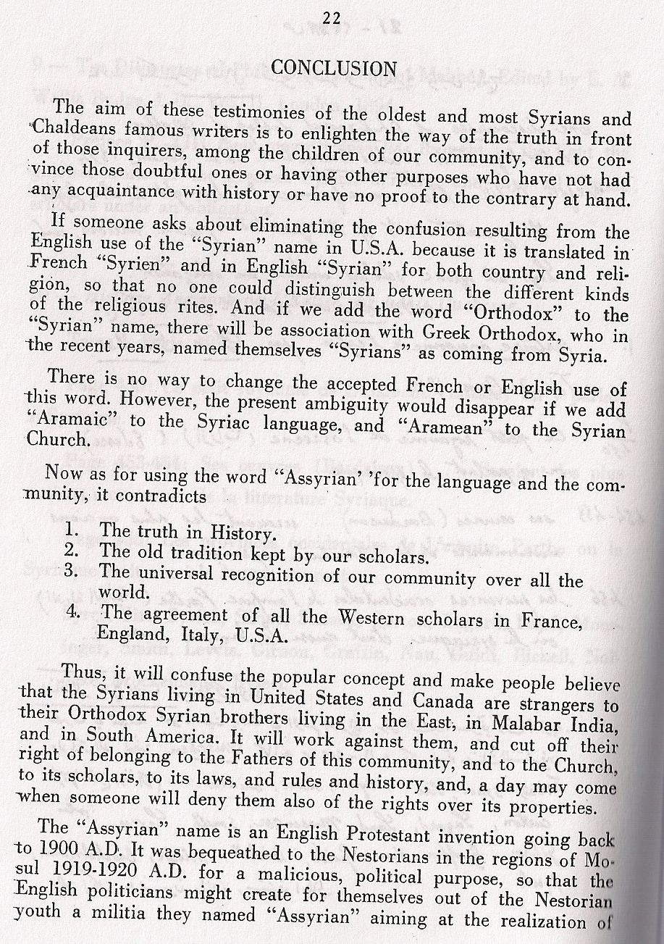
ܡܪܝ ܐܓܢܐܛܝܘܣ ܐܦܪܝܡ ܩܕܡܝܐ ܒܪܨܘܡ

Slide 63
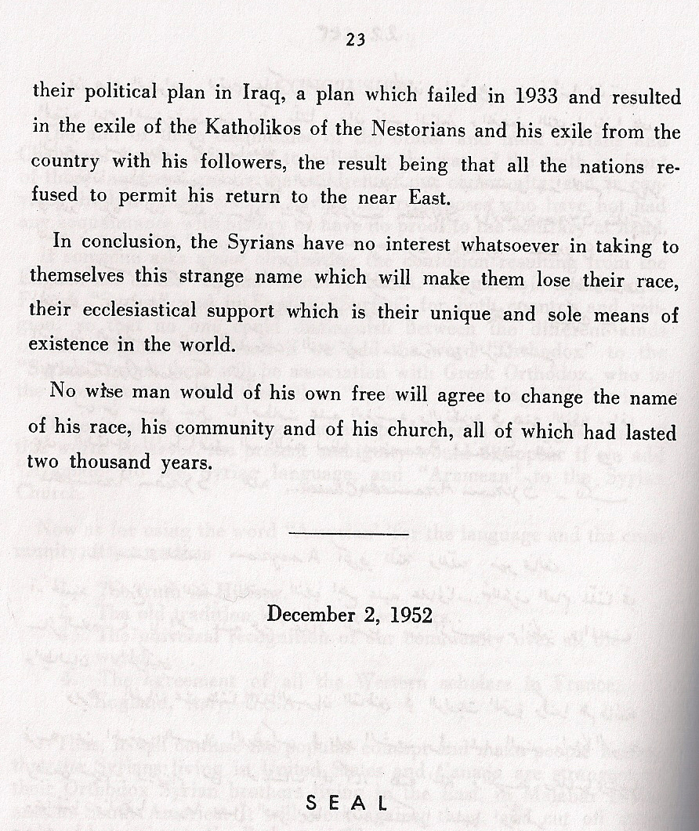
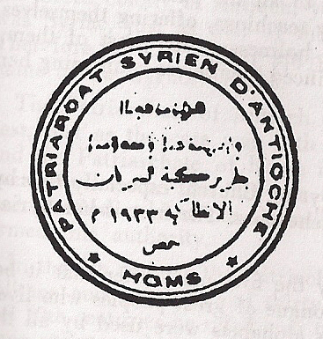
ܡܪܝ ܐܓܢܐܛܝܘܣ ܐܦܪܝܡ ܩܕܡܝܐ ܒܪܨܘܡ

Slide 64
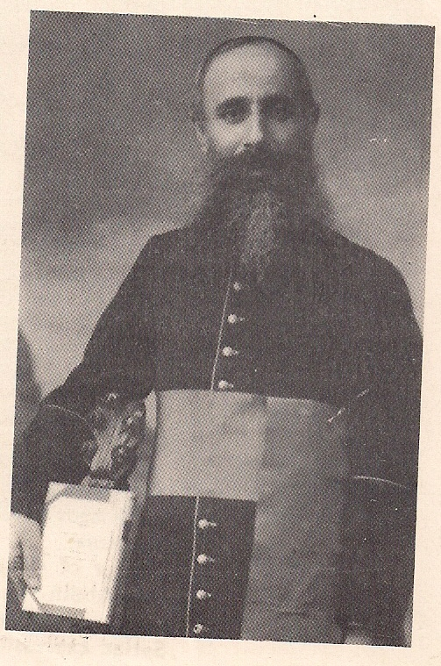
ܩܫܝܫܐ ܣܘܪܝܝܐ ܩܬܘܠܝܩܝܐ ܐܝܣܚܩ ܒܪ ܐܪܡܠܬܐ
Syrian Catholic priest Ishak Bar Armalto (Ishaq Armale)(1879-1954):
ܡܐܠܘܢ ܕܝܢ ܠܘܬ ܒܢܰܝܳܐ ܣܘܪܝܝܶܐ ܗܳܢܘܢ ܕܒܪܚܡܬ ܐܳܪܳܡܳܝܽܘܬܐ ܨܒܺܝܥܺܝܢ ܘܰܪܬܺܝܚܺܝܢ... ܢܺܐܬܶܐ ܠܢ ܕܫܥܬܐ ܕܒܦܬܓܡܶܐ ܩܪܝܚܶܐ ܘܰܕܢܺܝܚܶܐ: ܕܰܡܒܰܣܡܺܝܢ ܠܪܥܝܢܶܐ ܫܒܺܝܚܶܐ ܘܢܺܝܚܶܐ: ܠܢܶܨܚܢܶܝܗ̇ ܪܡܶܐ ܘܠܫܘܦܪܶܝܗ̇ ܦܐܝܳܐ ܕܐܳܪܳܡܳܝܽܘܬܳܐ ܢܒܰܕܶܩ ܘܢܡܠܠ...
(see introduction of kthobo d-regath shabre, printed in the syriac catholic patriarchate in the school of Sharfe, Lebanon, 1908)

Slide 65
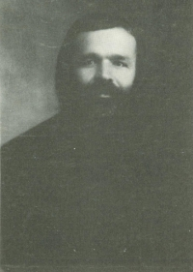
ܦܘܠܘܣ ܟܦܪܢܝܫܝܐ
̇Boulous al-Khoury al-Kfarnisy (1888-1963) Syriac Maronite church:
"Now I seek you, the children of Aram, what ever is your church denomination to remember your high origin and glorious history and to take care of your noble language..."
(Grammaire de la langue Araméene syriaque, second edition, Beirut 1962, introduction p. 18)

Slide 66
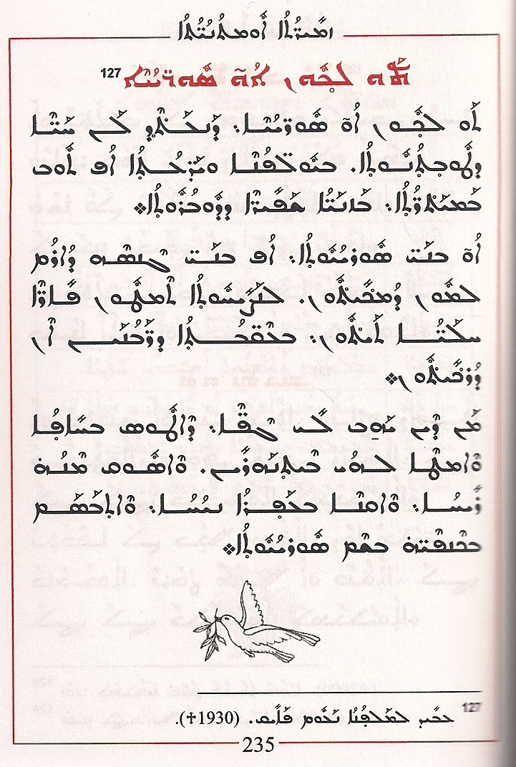
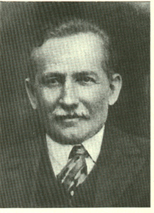
ܡܠܦܢܐ ܢܥܘܡ ܐܠܝܐܣ ܝܥܩܘܒ ܒܐܠܟ (ܦܐܝܩ)
Naum Palak (Fayeq, +1930) from Omid/Diyarbakir

Slide 67
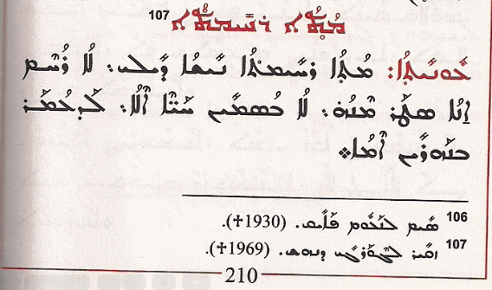
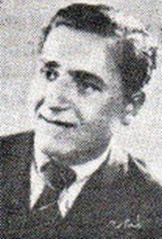
ܓܘܪܓܝ ܕܢܗܫ
George Danhash (+1969)

Slide 68
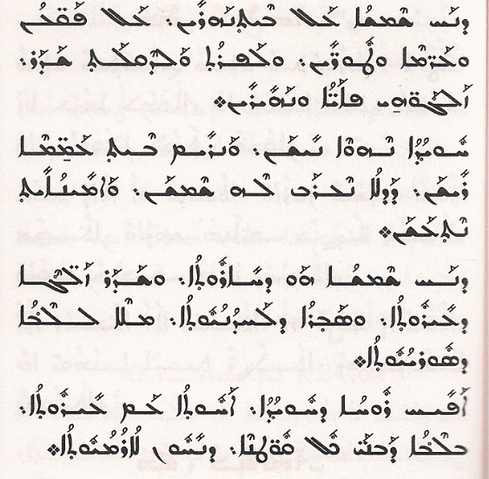
ܓܘܪܓܝ ܕܢܗܫ

Slide 69
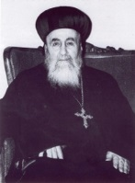
ܡܪܝ ܦܝܠܝܟܣܝܢܘܣ ܝܘܚܢܢ ܕܘܠܐܒܢܝ
Mor Philoxinos Yuhanon Dolabani (1885-1969)syrian orthodox bishop of Mardin:
ܕܠܶܥܙܐ ܐܳܪܳܡܳܝܳܐ ܐܠܨܝ ܗܘ ܠܢ ܠܳܐܪܳܡܳܝܶܐ ܡܢ ܟܠ ܠܥܙܝܢ: ܒܰܕ ܠܫܢܐ ܗܘ ܕܓܢܣܢ.
"The Aramaic language is more important to us Arameans than any other language, because it is the tongue of our race.“
(kthobo d-deboritho, published by Verlag Bar Hebräus, Losser-Holland, 1986 p. 16)

Slide 70
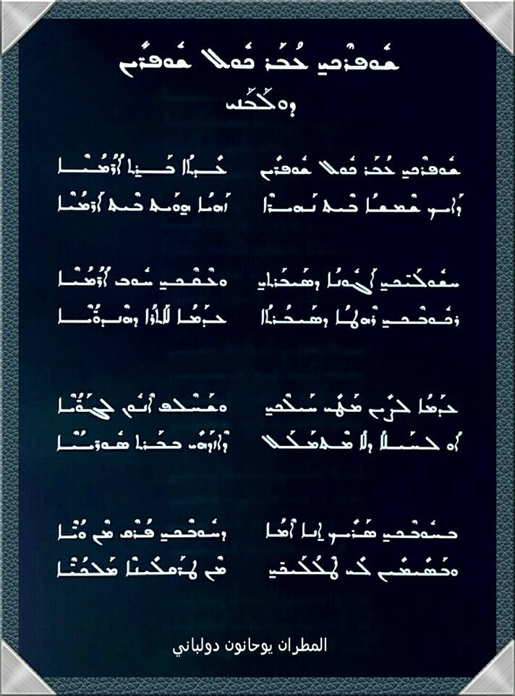
ܡܪܝ ܦܝܠܘܟܣܝܢܘܣ ܝܘܚܢܢ ܕܘܠܐܒܢܝ

Slide 71
ܡܪܝ ܦܝܠܘܟܣܝܢܘܣ ܝܘܚܢܢ ܕܘܠܐܒܢܝ
ܐܟ ܒܘܚܢܐ ܚܬܝܬܐ ܕܝܕܘܥܬܢܐ܆ ܫܟܚܬܐ ܗܝ ܕܳܐܪܳܡܳܝܶܐ ܐܘܡܢܘܬܐ ܕܟܬܘܒܘܬܐ. ܡܢܗܘܢ ܕܝܢ ܩܒܠܘܗ ܝܘܢܝܶܐ ܘܪܗܘܡܝܶܐ ܘܣܪܩܝܶܐ ܘܦܪܣܝܶܐ ܘܐܪܡܢܝܶܐ. ܠܐܳܪܳܡܳܝܶܐ ܡܕܝܢ ܛܝܒܘܬܐ ܕܠܐ ܡܬܦܚܡܐ ܥܠ ܟܠܗ ܐܢܫܘܬ.
"And as a careful examination by scholars (shows), the art of writing was a discovery of the Arameans; and among those who received it were the Greeks and the Romans, and the Saracens (i.e. Arabs), and the Persians, and the Armenians. Therefore, for the Arameans it is a blessing without equal among all mankind."
(kthobo d-deburitho, published by Verlag Bar Hebräus, Losser-Holland, 1986 , p. 22)

Slide 72
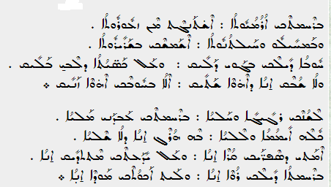
ܪܚܡܬ ܐܪܡܝܘܬܐ

Slide 73
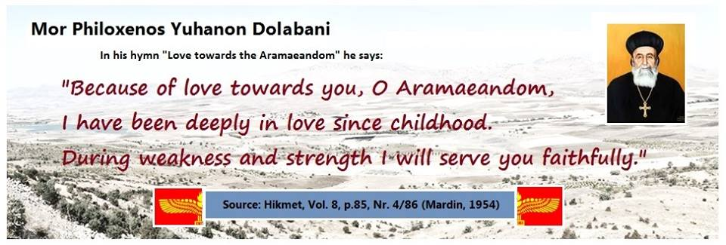
ܡܪܝ ܦܝܠܘܟܣܝܢܘܣ ܝܘܚܢܢ ܕܘܠܐܒܢܝ

Slide 74
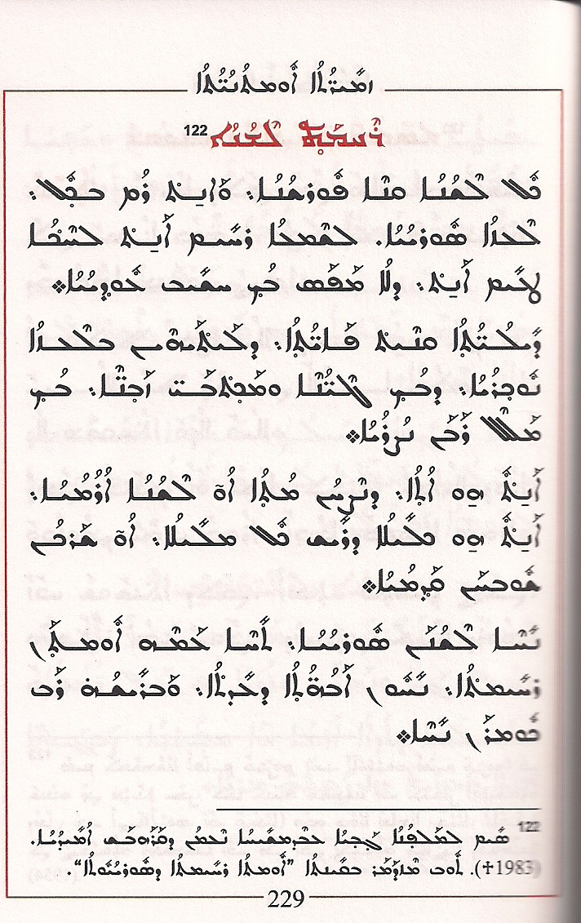
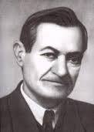
ܥܒܕܡܫܝܚܐ ܢܥܡܢ ܕܩܪܗܒܫ

Slide 75
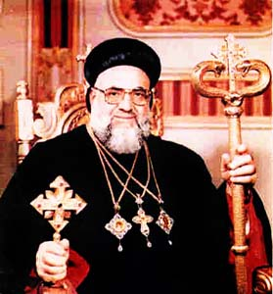
ܡܪܢ ܡܪܝ ܐܝܓܢܛܐܝܘܣ ܙܟܝ ܩܕܡܝܐ ܒܝܬ ܥܐܘܨ
Syriac Orthodox Patriarch Mor Ignatius Zakay I Iwas (patr. 1980-2014)

Slide 76
ܡܪܢ ܡܪܝ ܐܝܓܢܛܐܝܘܣ ܙܟܝ ܩܕܡܝܐ ܒܝܬ ܥܐܘܨ
Syriac Orthodox Patriarch Mor Ignatius Zakay I Iwas (patr. 1980-2014)
ܠܫܢܐ ܣܘܪܝܝܐ܆ ܗܘܝܘ ܠܫܢܐ ܐܪܡܝܐ ܒܝܳܬܶܗ. ܘܐܪܡܝܶܐ ܗܢܘܢ ܐܢܘܢ ܣܘܪܝܝܶܐ. ܘܦܰܕ ܠܗ ܗܘ ܕܦܪܫ ܠܐܪܡܝܶܐ ܡܢ ܣܘܪܝܝܶܐ.
̊Det syriska språket är detsamma som det arameiska språket, och Araméerna är syrianerna den som gör skillnad mellan araméer och syrianer begår ett stort misstag”
(Metropolit Zakka Iwas, jetziger Patriarch der syrisch-orthodoxen Kirche von Antiochen: Die Syrisch-Orthodoxe Kirche durch die Jahrhunderte. Holland 2006, 7)
(Den syriska kyrkan av Antiokia genom tiderna sidan. 10)

Slide 77
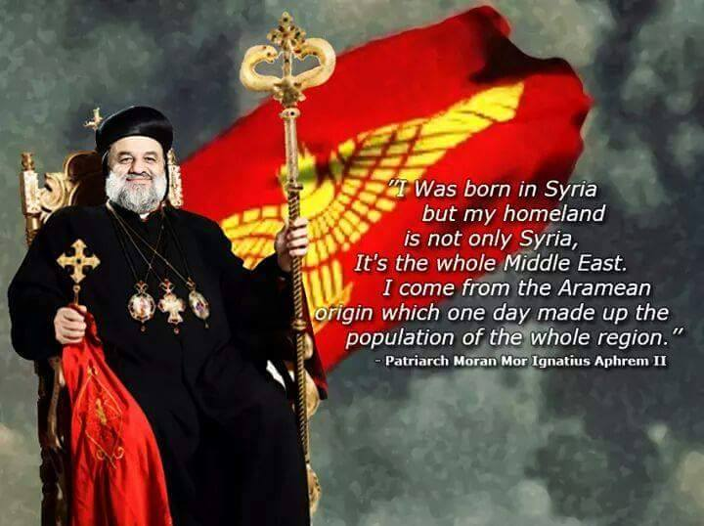
ܡܪܝ ܐܝܓܢܛܐܝܘܣ ܐܦܪܝܡ ܬܪܝܢܐ ܟܪܝܡ
Present day patriarch of the Syriac Orthodox Church Ignatius Aphrem II

Slide 78
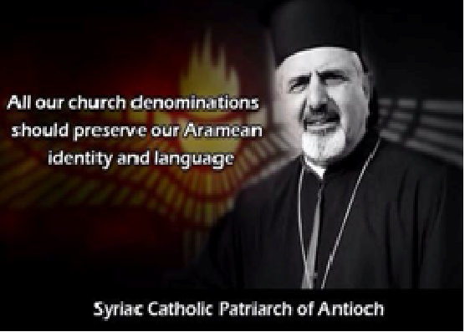
ܡܪܝ ܐܝܓܢܛܐܝܘܣ ܝܘܣܦ ܬܠܝܬܝܐ ܝܘܢܢ
Syriac Catholic patriarch Ignatius Joseph III Yonan

Slide 79
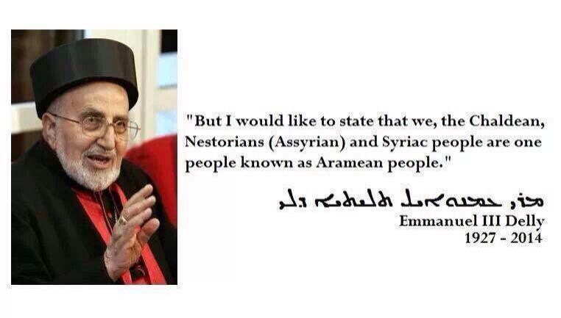
ܡܪܝ ܥܡܢܘܐܝܠ ܬܠܝܬܝܐ ܕܠܝ ܕܥܬܐ ܟܠܕܝܬܐ
Former Chaldean Catholic patriarch of Babylon

Slide 80
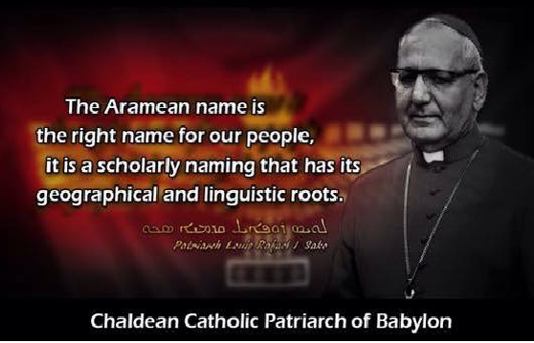
ܡܪܝ ܪܦܐܝܠ ܠܘܝܣ ܣܟܐ
Mar Raphael Louis Sako
http://saint-adday.com/permalink/7370.html

Slide 81

ܡܪܝ ܓܪܝܓܘܪܝܘܣ ܡܠܟܐ ܐܘܪܟ
Gregorius Malke Urek Syriac Orthodox Bishop of Adiyaman (Turkey):

Slide 82


ܡܪܝ ܬܐܘܦܝܠܘܣ ܓܘܪܓܝ ܨܠܝܒܐ

Slide 83

ܡܪܝ ܬܐܘܦܝܠܘܣ ܓܘܪܓܝ ܨܠܝܒܐ

Slide 84

ܐܘܓܝܢ ܦܘܠܘܣ ܡܢܘܦܪ ܒܝܬ ܒܪܨܘܡ
Augin Fawlus Manufar Beth Barsaum

Slide 85

ܐܘܓܝܢ ܦܘܠܘܣ ܡܢܘܦܪ ܒܝܬ ܒܪܨܘܡ

Slide 86


ܐܘܓܝܢ ܦܘܠܘܣ ܡܢܘܦܪ ܒܝܬ ܒܪܨܘܡ
Augin Fawlus Manufar Beth Barsaum

Slide 87


ܟܘܪܝܐ ܫܡܥܘܢ ܓܒܪܝܐܠ

Slide 88
Songs ܙܡܪܐ

Slide 89

Fuad Ispir
The singer Fuad Ispir from Qamishli (Syria) sings about Arameans, ”Beth Nahrin”, ”Grohamnekh Oromoyto,” ”Umtho d Orom” (Oromoye Suryoye) and many more .

Slide 90
Popularity of the Aramean name

Slide 91


Slide 92


Slide 93


Slide 94


Slide 95


Slide 96


Slide 97


Slide 98


Slide 99


Slide 100


Slide 101


Slide 102


Slide 103


Slide 104


Slide 105


Slide 106


Slide 107


Slide 108


Slide 109


Slide 110


Slide 111


Slide 112


Slide 113


Slide 114


Slide 115


Slide 116


Slide 117


Slide 118


Slide 119


Slide 120


Slide 121



Slide 122


Slide 123
Thanks To:
SAUF, Syrianska Arameiska Ungdomsförbundet
Assad Sauma Assad,(Sweden)
Shabo Hanna (Germany)
Henri Bedros Kifa (France)
Zakay Joseph (Germany)
Johny Messo (Netherlands) (president of the WCA)
Nahir Akcay Hahoyo (Deyroyo) ((ܩܘܩܢܘܣ ܕܢܥܡܬܐ
Gabriel Rabo (Germany)

Slide 124
ܽ
ܫܠܡ

